Slide 1
Emergency Planning
Webinar – June 2018

Slide 2

Presenters
Craig Thornton
  Chief Marketing Officer, Mango Limited
  craig@mangolive.com
  New Zealand
  +64 29 377 5444
  @mangolimited
  LinkedIn
  Blog – www.mangolive.com

Slide 3

Presenters
Laurie O’Donoghue
  Managing Director - Total Management and Training
  laurie@totalmantra.com.au
  Australia
  +61 427 100 454
  www.totalmantra.com.au

Slide 4
Who are we?
Total Management and Training is a management consultancy and registered training organisation based in Cairns, Australia offering consultancy, nationally accredited courses and competencies across a range of industries. TMT has a reputation of providing prompt, professional service, using qualified, experienced consultants and trainers to deliver up-to-date, industry standard training and advice.
  Qualifications in Work Health and Safety
  Qualifications in Business
  Qualifications in Training and Assessment
  Work Health and Safety Representative training
  Fire and Emergency Training
  General Health and Safety Training in including courses in confined space entry, working at heights, asbestos removal, test and tag, emergency warden, construction induction and many others.
  Health and safety general consulting
  Development of health and safety procedures, systems & manuals
  Conduct health and safety inspections
  System and compliance auditing
  Approved Federal and State construction auditor
www.totalmantra.com.au

Slide 5
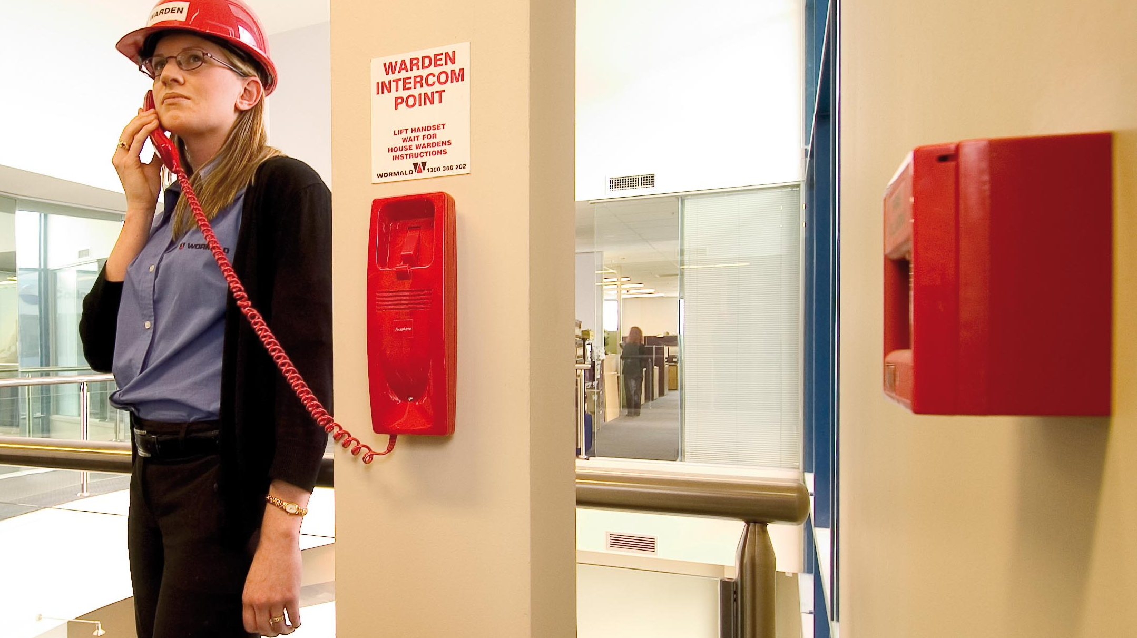
Dealing with Emergencies

Slide 6
Legislation – Emergency Planning
WHS legislation across Australia & New Zealand requires that
An Emergency Plan is prepared for the workplace
In the preparation of the Emergency Plan the organisation must take into account
  the nature of the work being carried out at the workplace
  the nature of the hazards at the workplace
  the size and location of the workplace
  the number and composition of the workers and other persons at the workplace

Slide 7
Legislation – Emergency Planning
WHS legislation across Australia & New Zealand requires that
The Emergency Plan includes
  an effective response to an emergency
  evacuation procedures
  notifying emergency service organisations at the earliest opportunity
  medical treatment and assistance
  effective communication between the person authorised to coordinate the emergency response and all persons at the workplace
  testing of the emergency procedures, including the frequency of testing
  information, training and instruction to relevant workers in relation to implementing the emergency procedures

Slide 8
Legislation – Emergency Planning
WHS legislation across Australia & New Zealand requires that
The Emergency Plan is maintained so it remains effective
Specific plans are put in place for
  First aid
  Hazardous chemicals
  Hazard specific emergencies (e.g. confined space entry)

Slide 9
Legislation – Emergency Planning
Examples of legislation which is applicable to emergencies includes:
Fire
    Fire and evacuation plans
    Evacuation signs and diagrams
    Fire and evacuation instructions
    Fire safety advisor
    Evacuation coordination instructions
    Evacuation practice
    Records
Radiation
Environmental

Slide 10
Legislation – Dealing with Emergencies
QLD Building Fire Safety Regulation 2008
  Part 2 Means of escape from buildings
  Part 4 Evacuation, planning, instruction and practice
    Fire and evacuation plans
    Evacuation signs and diagrams
    Fire and evacuation instructions
    Fire safety advisor
    Evacuation coordination instructions
    Evacuation practice
    Records

Slide 11
Sources of Information
Ambulance Service
Fire and Rescue
Police Service
Environmental Protection Agency
Work Health and Safety Regulators
Local Council
State Emergency Services
Electricity Supplier
Gas Supplier
Poisons Information Centre
Trauma Counselling Centres

Slide 12
Managing a Typical Emergency
Prevention
Preparation
Response
Recovery

Slide 13
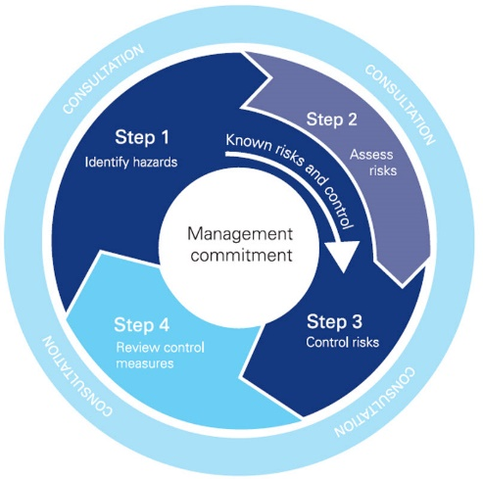
Prevention & Mitigation
Prevention is the action taken to decrease the likelihood that an event or crisis will occur.
Mitigation is the action taken to eliminate or reduce the loss of life and property damage related to an event or crisis, particularly those that cannot be prevented.
Prevention and mitigation is achieved through the application of the risk management process.
Source: How to Manage Work Health and Safety Risks Code of Practice – Safe Work Australia

Slide 14
Preparedness
Preparedness takes the form of plans or procedures designed to save lives and to minimize damage when an emergency occurs.
Objective of the emergency plan is to
  prevent fatalities and injuries;
  reduce damage to buildings, stock, and equipment;
  reduce damage to the environment;
  accelerate the resumption of normal operations.

Slide 15
Objective of the Emergency Plan
prevent fatalities and injuries;
reduce damage to buildings, stock, and equipment;
reduce damage to the environment;
accelerate the resumption of normal operations.

Slide 16
Potential Emergency Identification
Although emergencies are normally sudden events, their occurrence can be predicted with some degree of certainty.
The first step is to find which hazards (both natural and workplace / human) which pose a threat to any specific workplace.
This can be achieved by conducting a “Emergency Preparedness Assessment”

Slide 17
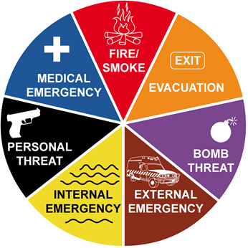
Emergency Preparedness Assessment
how likely a situation is to occur
what means are available to stop or prevent the situation and
what is necessary for a given situation

Slide 18
Emergency Preparedness Assessment
Natural
Earthquake | Rain
Cyclone | Subsidence
High wind | Temperature extremes
Flood | Tidal wave
Fire of natural origin | Volcanic eruption
Hail and snow | Water
Landslide or mudslide | Wind
Lightening
Natural Hazards and Incidents

Slide 19
Emergency Preparedness Assessment
Workplace / Human Hazards and Incidents
Arson | Spills of flammable liquids
Bomb threat | Release of toxic substances
Armed robbery | Exposure to ionizing radiation
Electrical failure or malfunction | Loss of water supply
Machinery breakdown | Loss of communications
Medical emergency | Pollution
Fire and smoke | Riot
Explosion | Sabotage
Building collapse | Spontaneous combustion
Major structural failure | Terrorism

Slide 20
Emergency Preparedness Assessment
Specific workplace risks - examples
Trench collapse | Patient evacuation
Contact with overhead power | Lift emergency
Plant rollover | Lost tourist
Contact with electricity | White water raft emergency
Fall arrest recovery

Slide 21
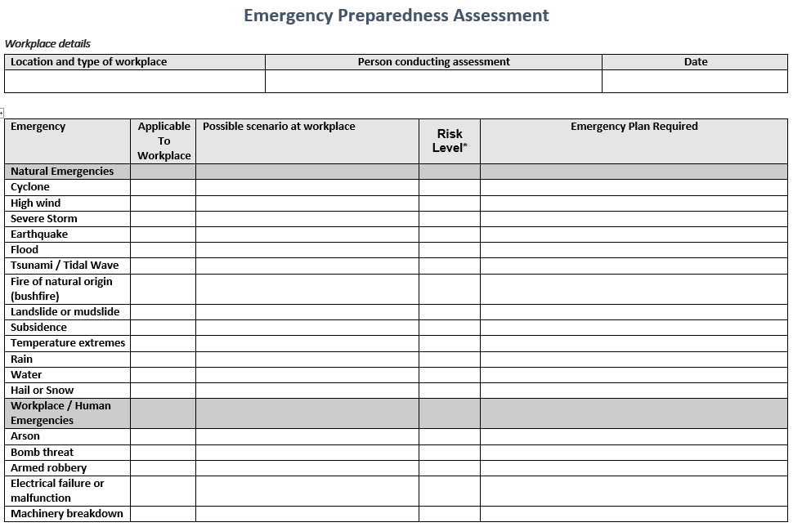
Emergency Preparedness Assessment
Hazard Identification
  Types of Hazards and Incidents
Identify Possible Impacts and Consequences
Develop Emergency Responses
Emergency Equipment and Resources

Slide 22
Preparation
AS3745 – Planning for emergencies
  Emergency Planning Committee (EPC)
  Emergency Plan
  Emergency Response Procedures
  Emergency Control Organisation (ECO)
  Training
  Emergency Response Exercises
  Review and Maintenance

Slide 23

Emergency Planning Committee
The EPC promulgates the emergency response plans and procedures and appoints members of the ECO.
Membership – representatives of the workplace (may include members of the ECO)

Slide 24
Emergency Planning Committee
EPC Responsibilities
  Ensuring an emergency preparedness assessment is undertaken for each building, structure and workplace
  Determine hazards which warrant specific procedures within the emergency management plan
  Develop and implement the emergency plan and response procedures
  Determine the number of ECO personnel
  Ensure that personnel are appointed to all ECO positions, especially the emergency coordinator and chief warden
  Determine who will conduct firefighting, first aid, environmental safety actions and shutdown procedures
  Organise training of the ECO personnel
  Ensure evacuation exercises are conducted at least annually
  Review the effectiveness of the evacuation exercises and arrange improvements where warranted
  Monitor the specific procedures and controls for the management of emergencies

Slide 25
Emergency Plan
Key Considerations
  The size and complexity of the facility
  Fire engineered or life safety features of the facility
  Security systems, procedures and protocols
  The number and nature of occupants and visitors
  The hours of occupancy. Cover times when there are only a few persons in the building (e.g. cleaners)
  Consider methods of communication
  Consider persons with disabilities
  Need to be varied for different circumstances (e.g. fire or bomb)
  Be kept as simple as possible

Slide 26
Emergency Plan
A clear statement of purpose and scope
Information on the structure and purpose of the EPC
Identification of the facilities to which it applies
Descriptions of the fire safety and emergency features of the facility
The organisational arrangements for the facility.
Separate sections for the following:
  Emergency identification (Emergency Preparedness Assessment) outcomes
  Emergency response procedures
  Evacuation diagram/s
Training arrangements
A statement of the extent of distribution of the emergency plan
A record of distribution
Details of the hours of occupancy
The EPC nominated validity period for the emergency plan
The date of issue or amendment date

Slide 27
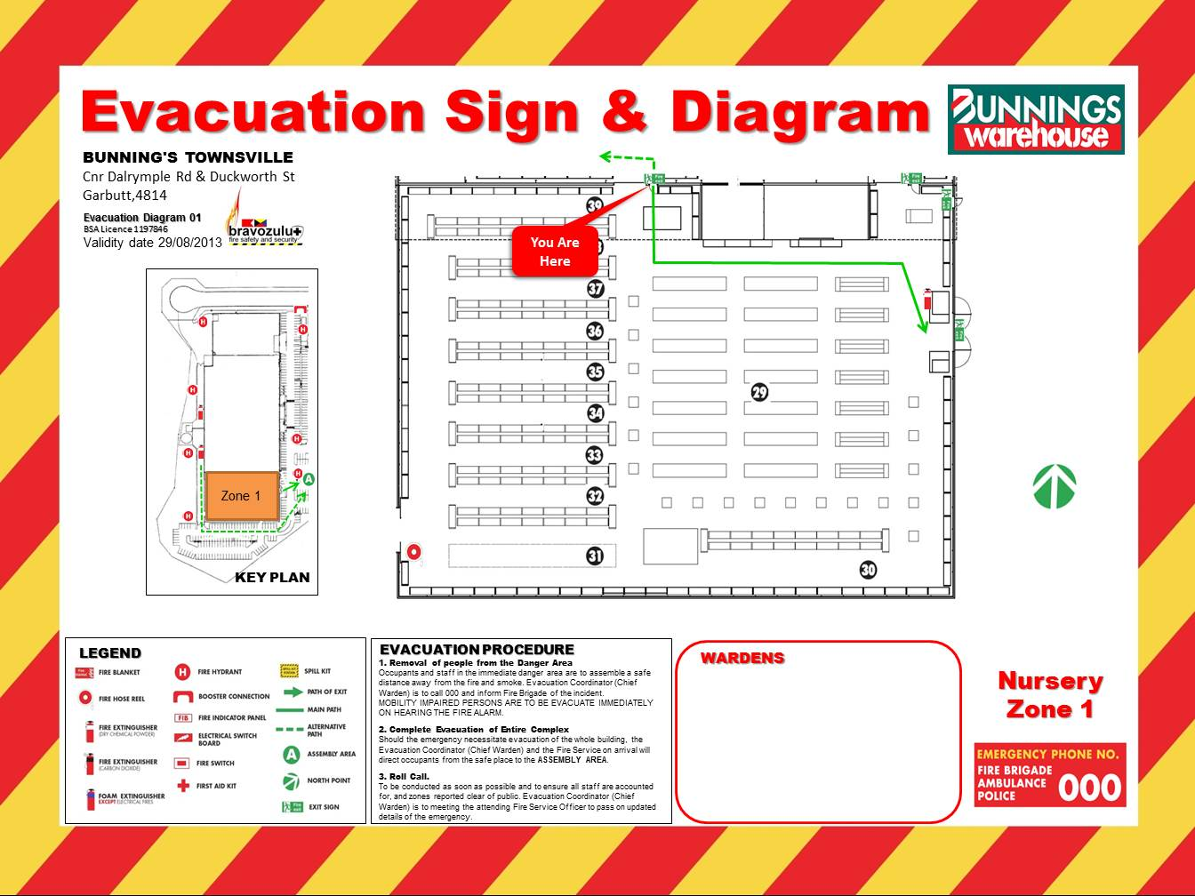
Emergency Diagram

Slide 28
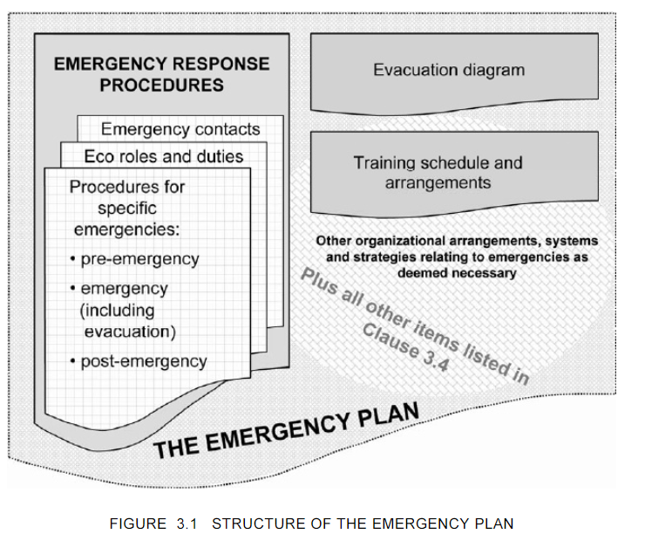
Source: AS3745 – Planning for emergencies

Slide 29
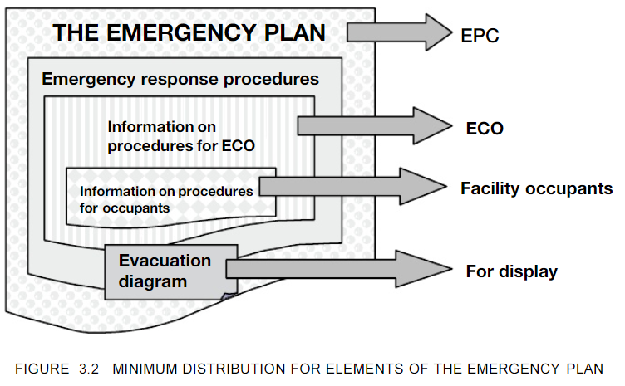
Source: AS3745 – Planning for emergencies

Slide 30
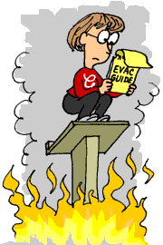
Emergency Response Procedures
To be included in documented procedures
  Responsibilities and duties of the ECO and the actions they are to take
  Responsibilities and duties of occupants and the actions they are to take
  Instructions on evacuation
  Instruction for coordinating the evacuation
  The arrangements for emergency preparedness and response.
    Method for coordinating the alarm
    Method of operating fire fighting or other equipment
  Current emergency contact details
  Post Emergency actions

Slide 31
Emergency Response Procedures
Consider
After hours
Evacuation routes
Persons with disabilities
Lifts and escalators
Accounting for people
Assembly areas
Receptionist / Switchboard operator
Floor / Area Marshalling
Restrictions of vehicle movement
Control and coordination
Communications
First Aid Personnel
Emergency Response Equipment
Lift Safety Features
Security Guards / Specialist Staff
Other Considerations

Slide 32
Emergency Control Organisation
Number of members depends on size organisation
Generally includes
  Chief Fire Warden
  Communications Officer
  Floor or Area Wardens
  Wardens
  Deputies
Emergency response procedures include roles and responsibilities
During emergencies, instructions given by the emergency control organization (ECO)personnel shall take precedence over the normal management structure.

Slide 33





Chief Warden
Yellow
Floor Warden
Area Warden
Red
Warden
First Aid Personnel
Green Cross on White
White
Deputy Chief Warden
Comms Officer
Other ways to identify themselves are armbands, helmets, caps, hats, uniforms, tabards vests or other distinguishing distinctive clothing.

Slide 34
Training
What
Evacuation plans,
Alarm systems,
Reporting procedures for personnel,
Shutdown procedures, and
Types of potential emergencies.
Specialist Training
When
Initially when the plan is developed,
For all new employees,
When new equipment, materials, or processes are introduced,
When procedures have been updated or revised,
When exercises show that employee performance must be improved
At least annually.

Slide 35
Training
What
Evacuation plans,
Alarm systems,
Reporting procedures for personnel,
Use of emergency equipment (inc fire fighting equipment)
Shutdown procedures, and
Types of potential emergencies.
Specialist Training (EPC, ECO, specialist emergency response)
When
Initially when the plan is developed,
For all new employees,
When new equipment, materials, or processes are introduced,
When procedures have been updated or revised,
When exercises show that employee performance must be improved
At least annually.

Slide 36
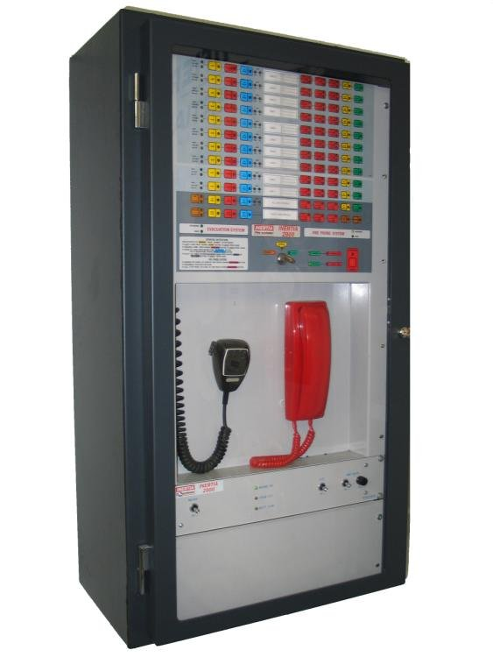
Emergency Equipment, Facilities and Alarms
Emergency Reporting
Emergency Alerting
Emergency Intercommunication
Emergency Warning and
Intercommunication Systems
(EWIS)

Slide 37
Emergency Equipment and Facilities
Fire
Hazardous Materials
Fire extinguishers
Fire blankets
Hose reels
Sprinkler systems
Smoke alarms
Smoke extraction systems
Stairwell pressurisation
Smoke doors
Smoke barriers
Fire compartments
Gas detectors
Self contained breathing apparatus
Spill kits
Splash suits and coveralls
Specialised alarms
Automatic closing doors and atmosphere extraction
Specialised PPE
Emergency showers/eye washers

Slide 38
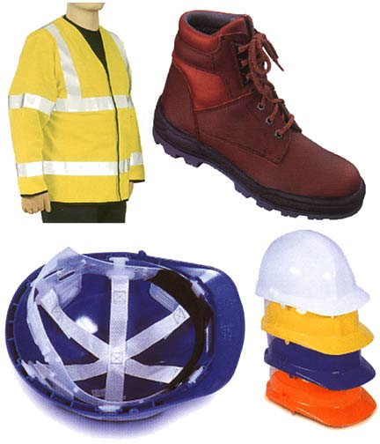
Emergency Equipment and Facilities
General
Personal Protective Equipment (PPE)
Emergency barrier tape
Signs
Gloves
Enclosed footwear
Safety glasses
Fire control panels
Manual alarms

Slide 39
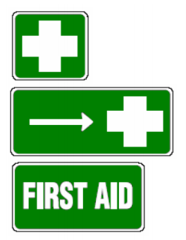
Emergency Equipment and Facilities
First Aid
First aid Kits
Automatic Defibrillators
Eye Wash and shower equipment
First aid room

Slide 40
After the Emergency
Debrief with personnel involved
Review the use of equipment
Identify equipment used
Report the use of the equipment
Record the use of equipment
Report any lost or damaged equipment
Report any equipment that needs replacement
Service used equipment
Ensure all equipment is in a ready state

Slide 41
Recovery from Emergencies
Just because an emergency has been controlled does not mean it is back to business as usual. An extensive recovery action may need to be taken. This may take longer and be more complex than the control of the emergency itself.

Slide 42
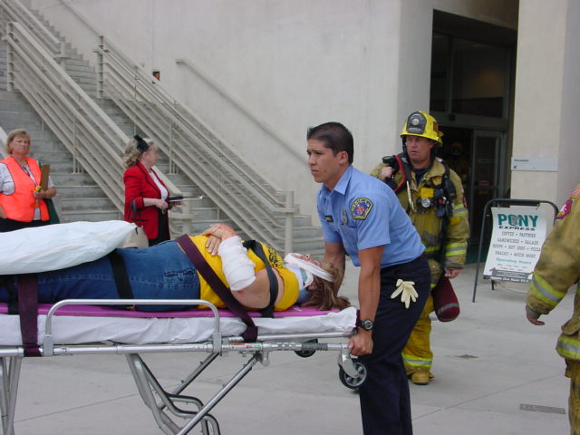
Emergency Plan Evaluation and
Review (Drills)

Slide 43
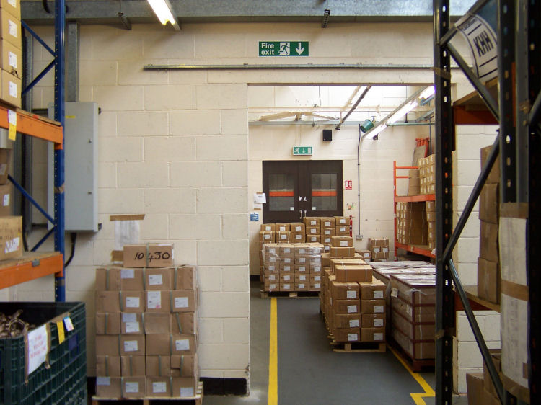
Review and Maintenance
Review Emergency Preparedness Assessment
Review Emergency Plan
Review Emergency Procedures
Conduct maintenance and inspections of all emergency facilities and equipment as required legislation, standards or by manufacturers instructions
Include emergency facilities and equipment in internal WHS inspection regimes

Slide 44
Questions ????

